Slide 1

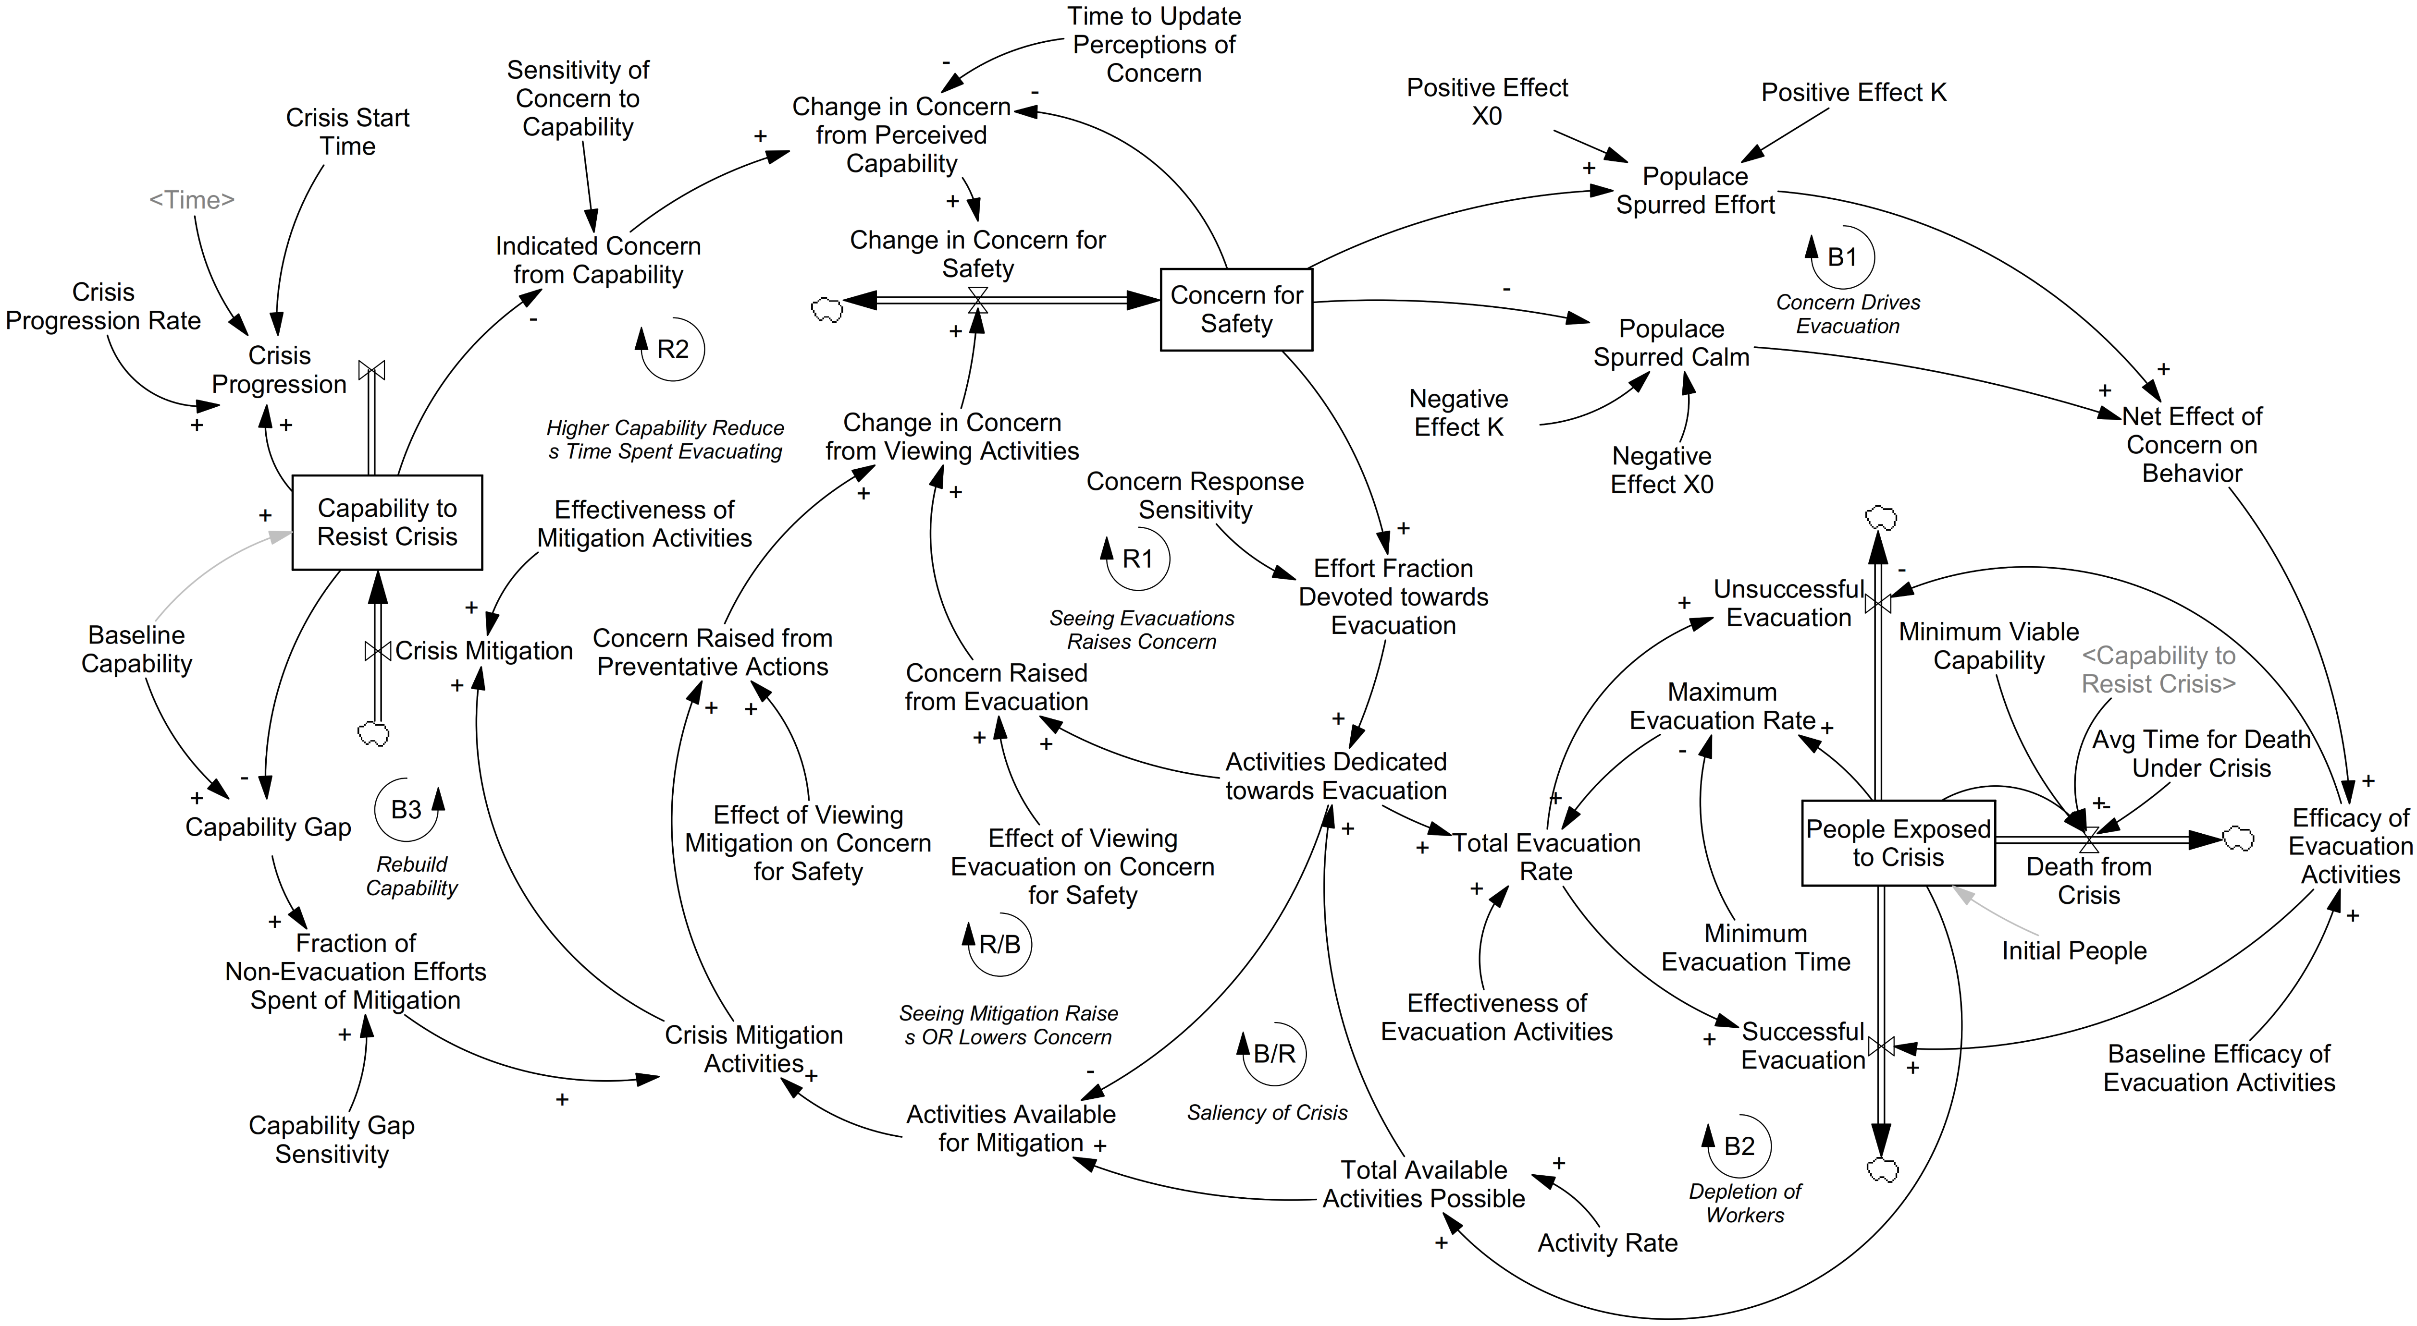
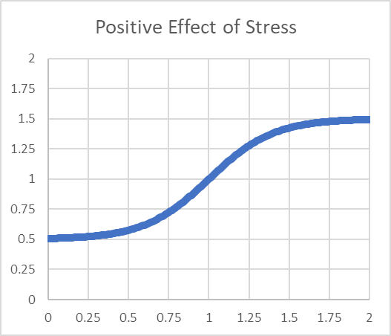
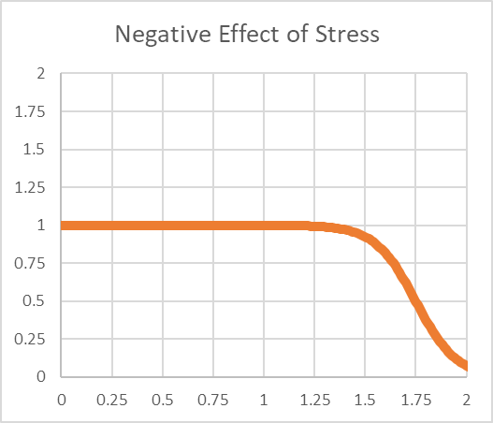
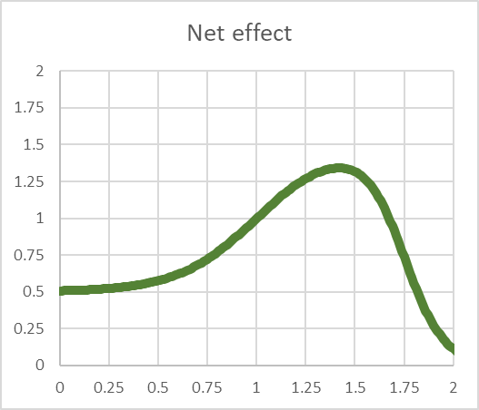
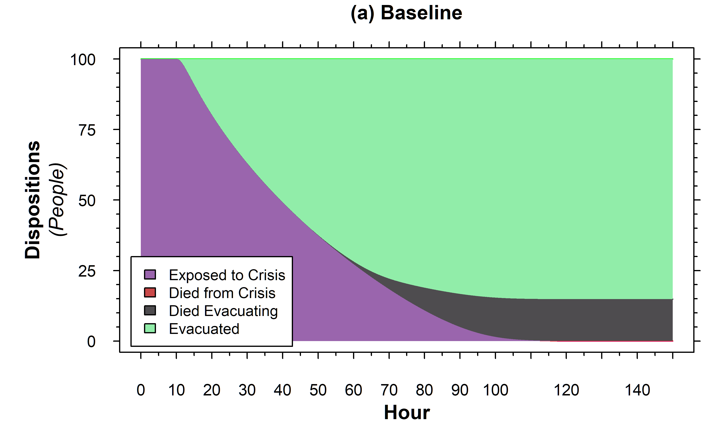
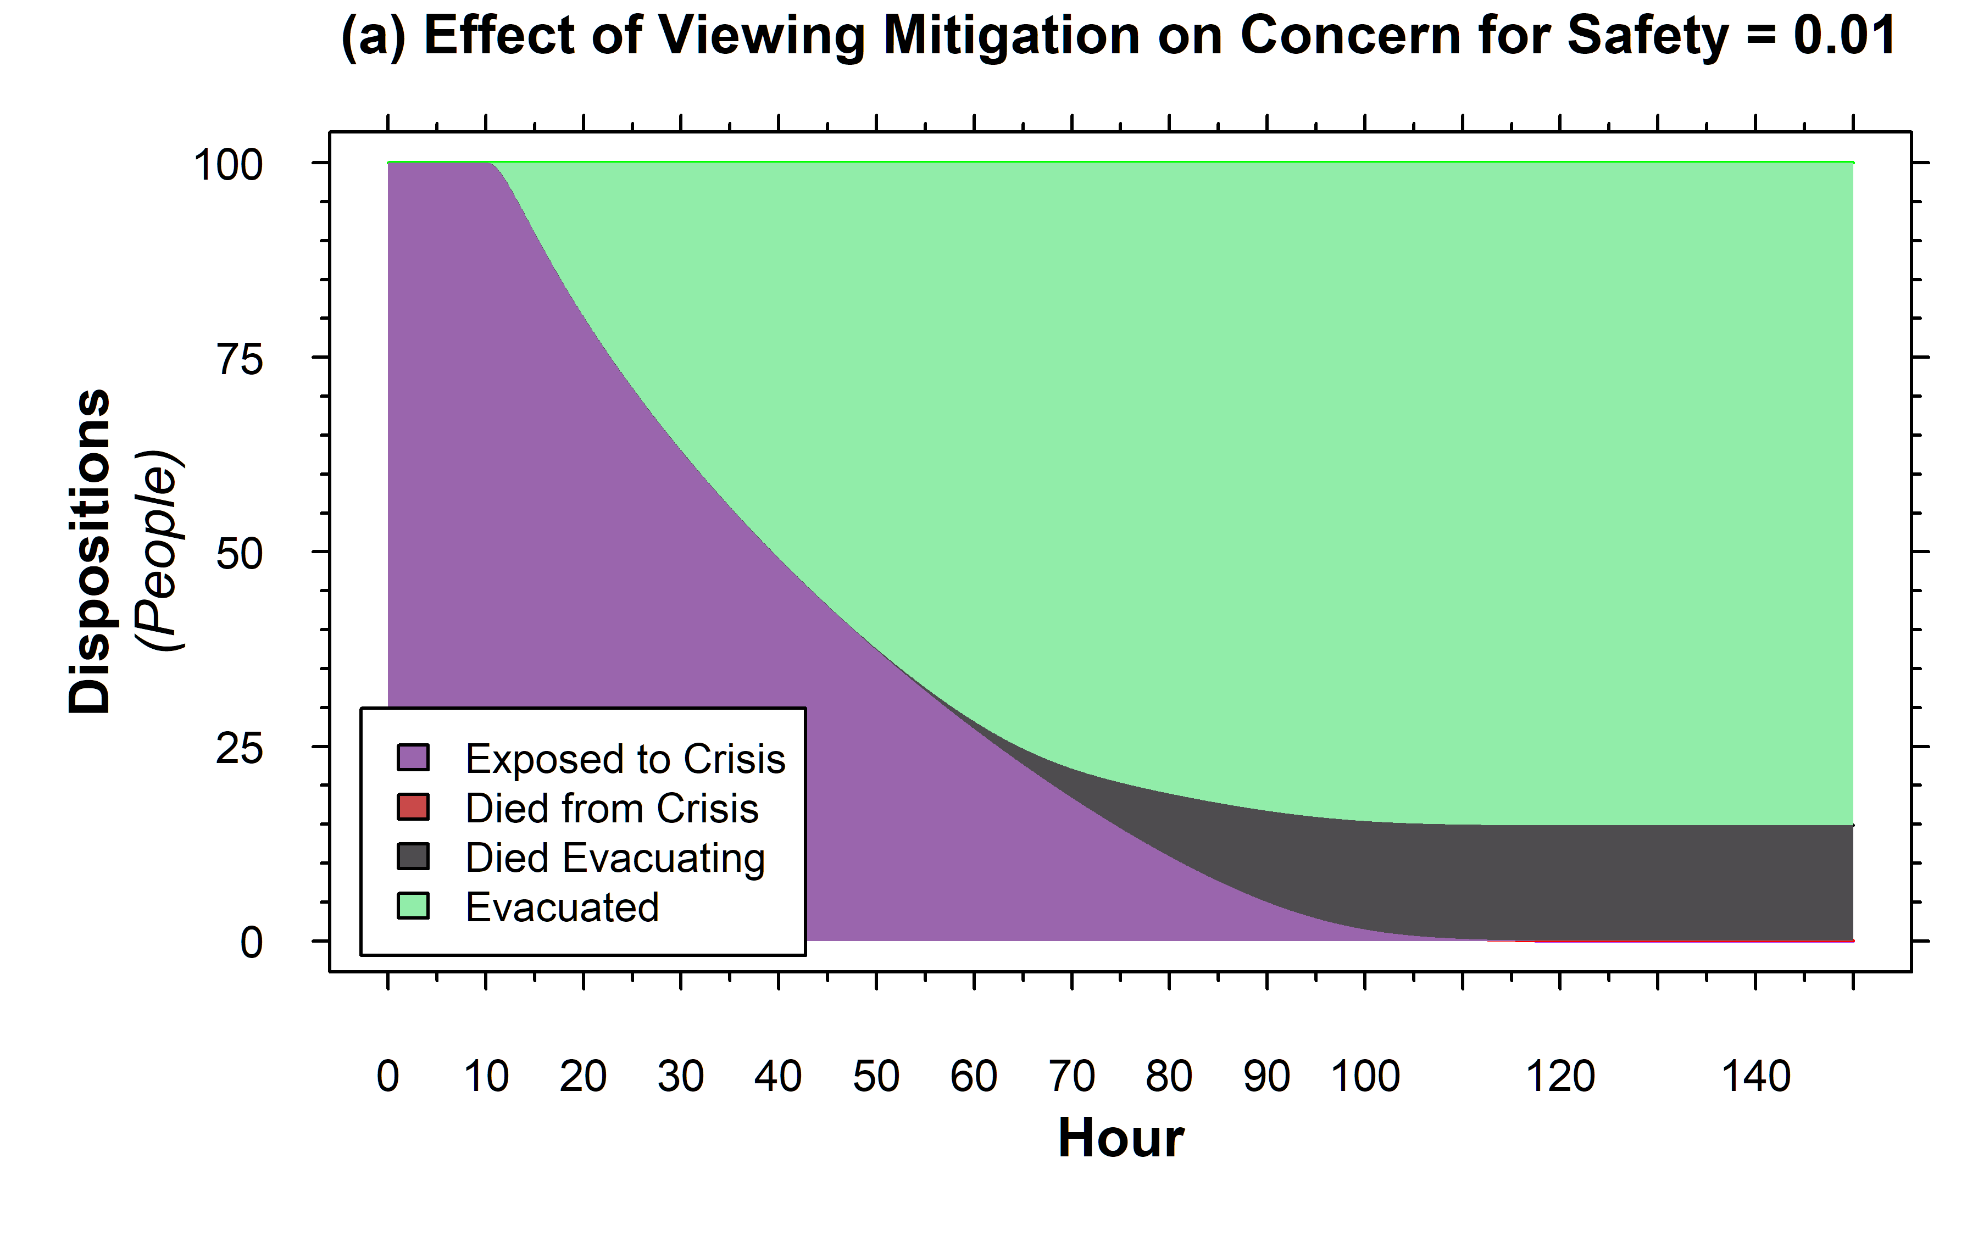
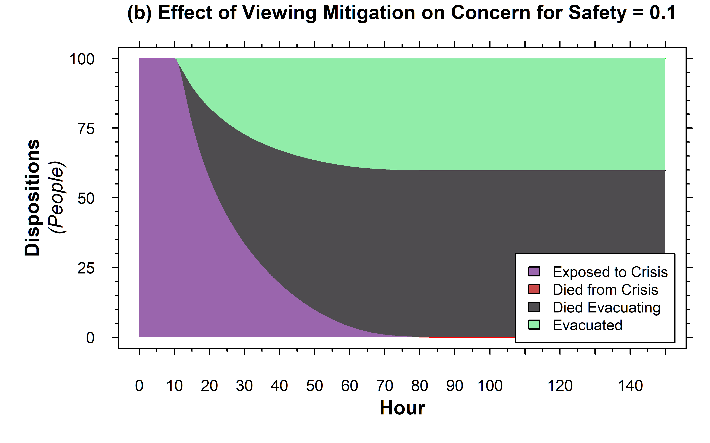
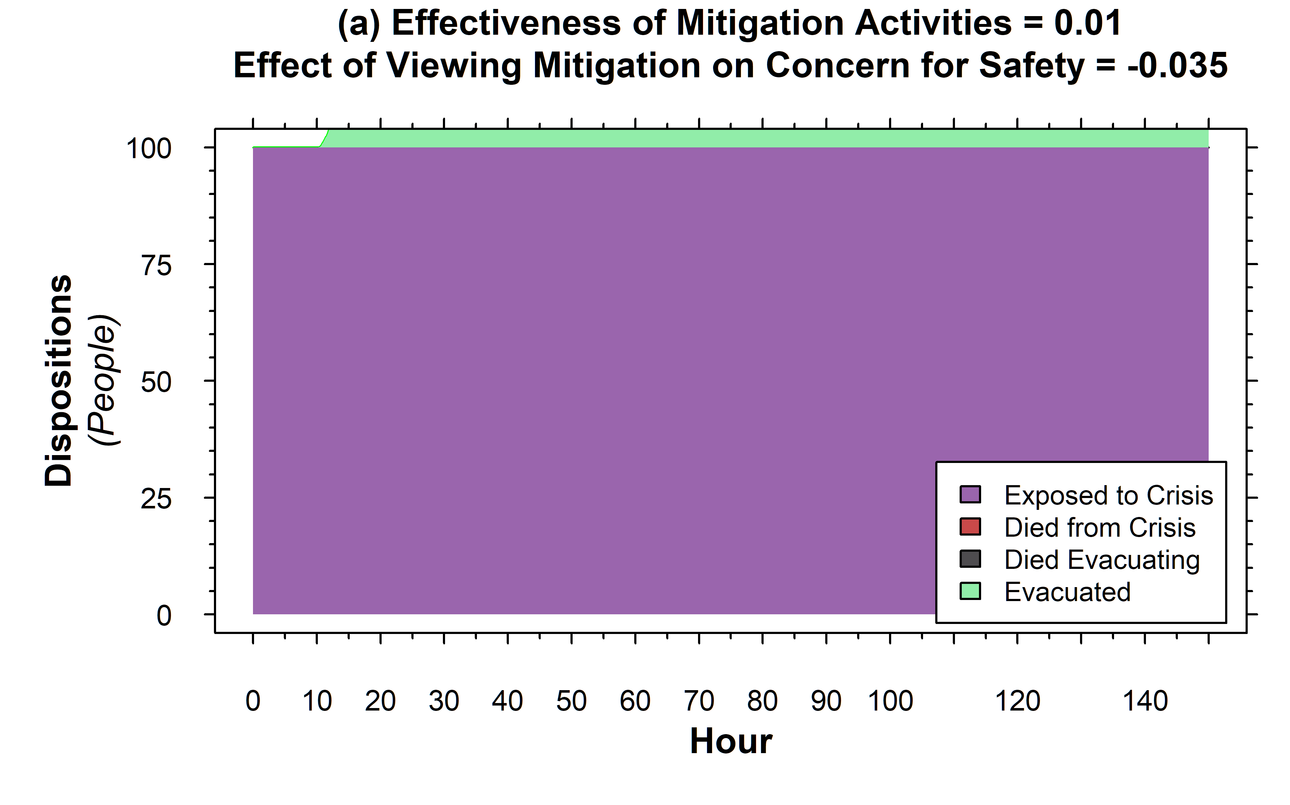
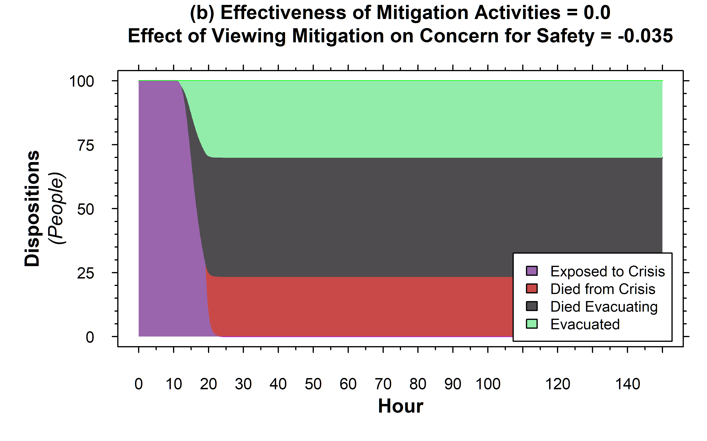
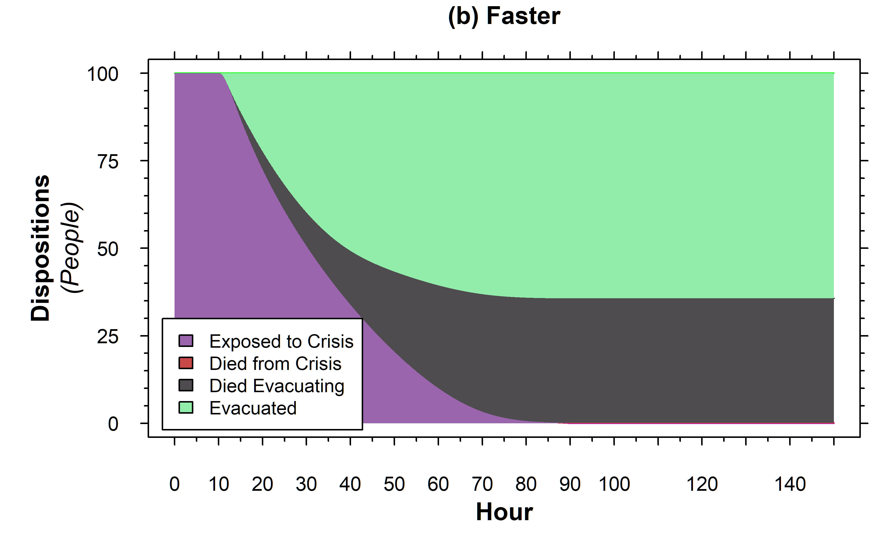
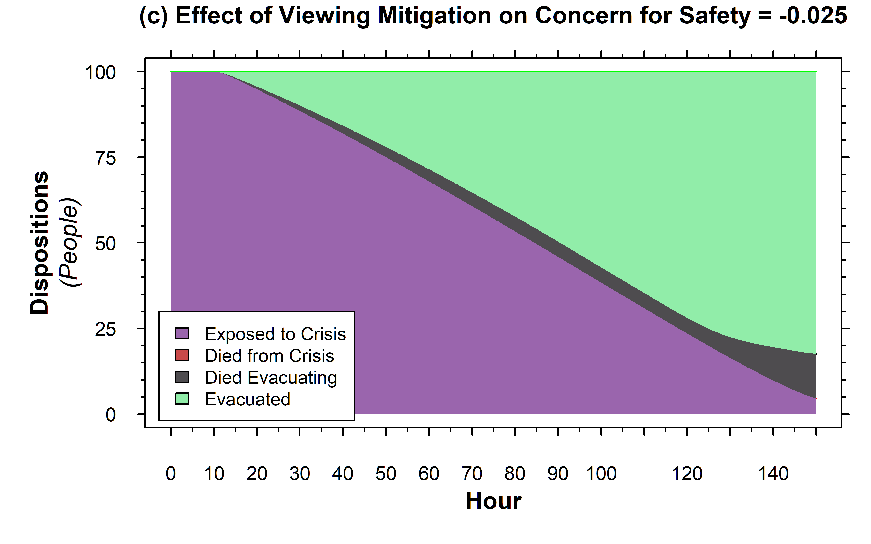
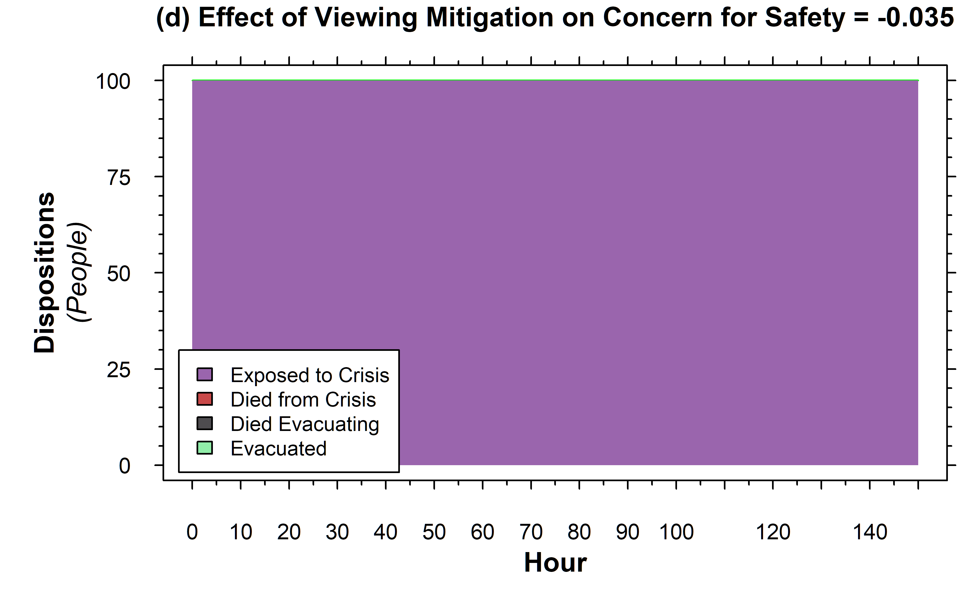
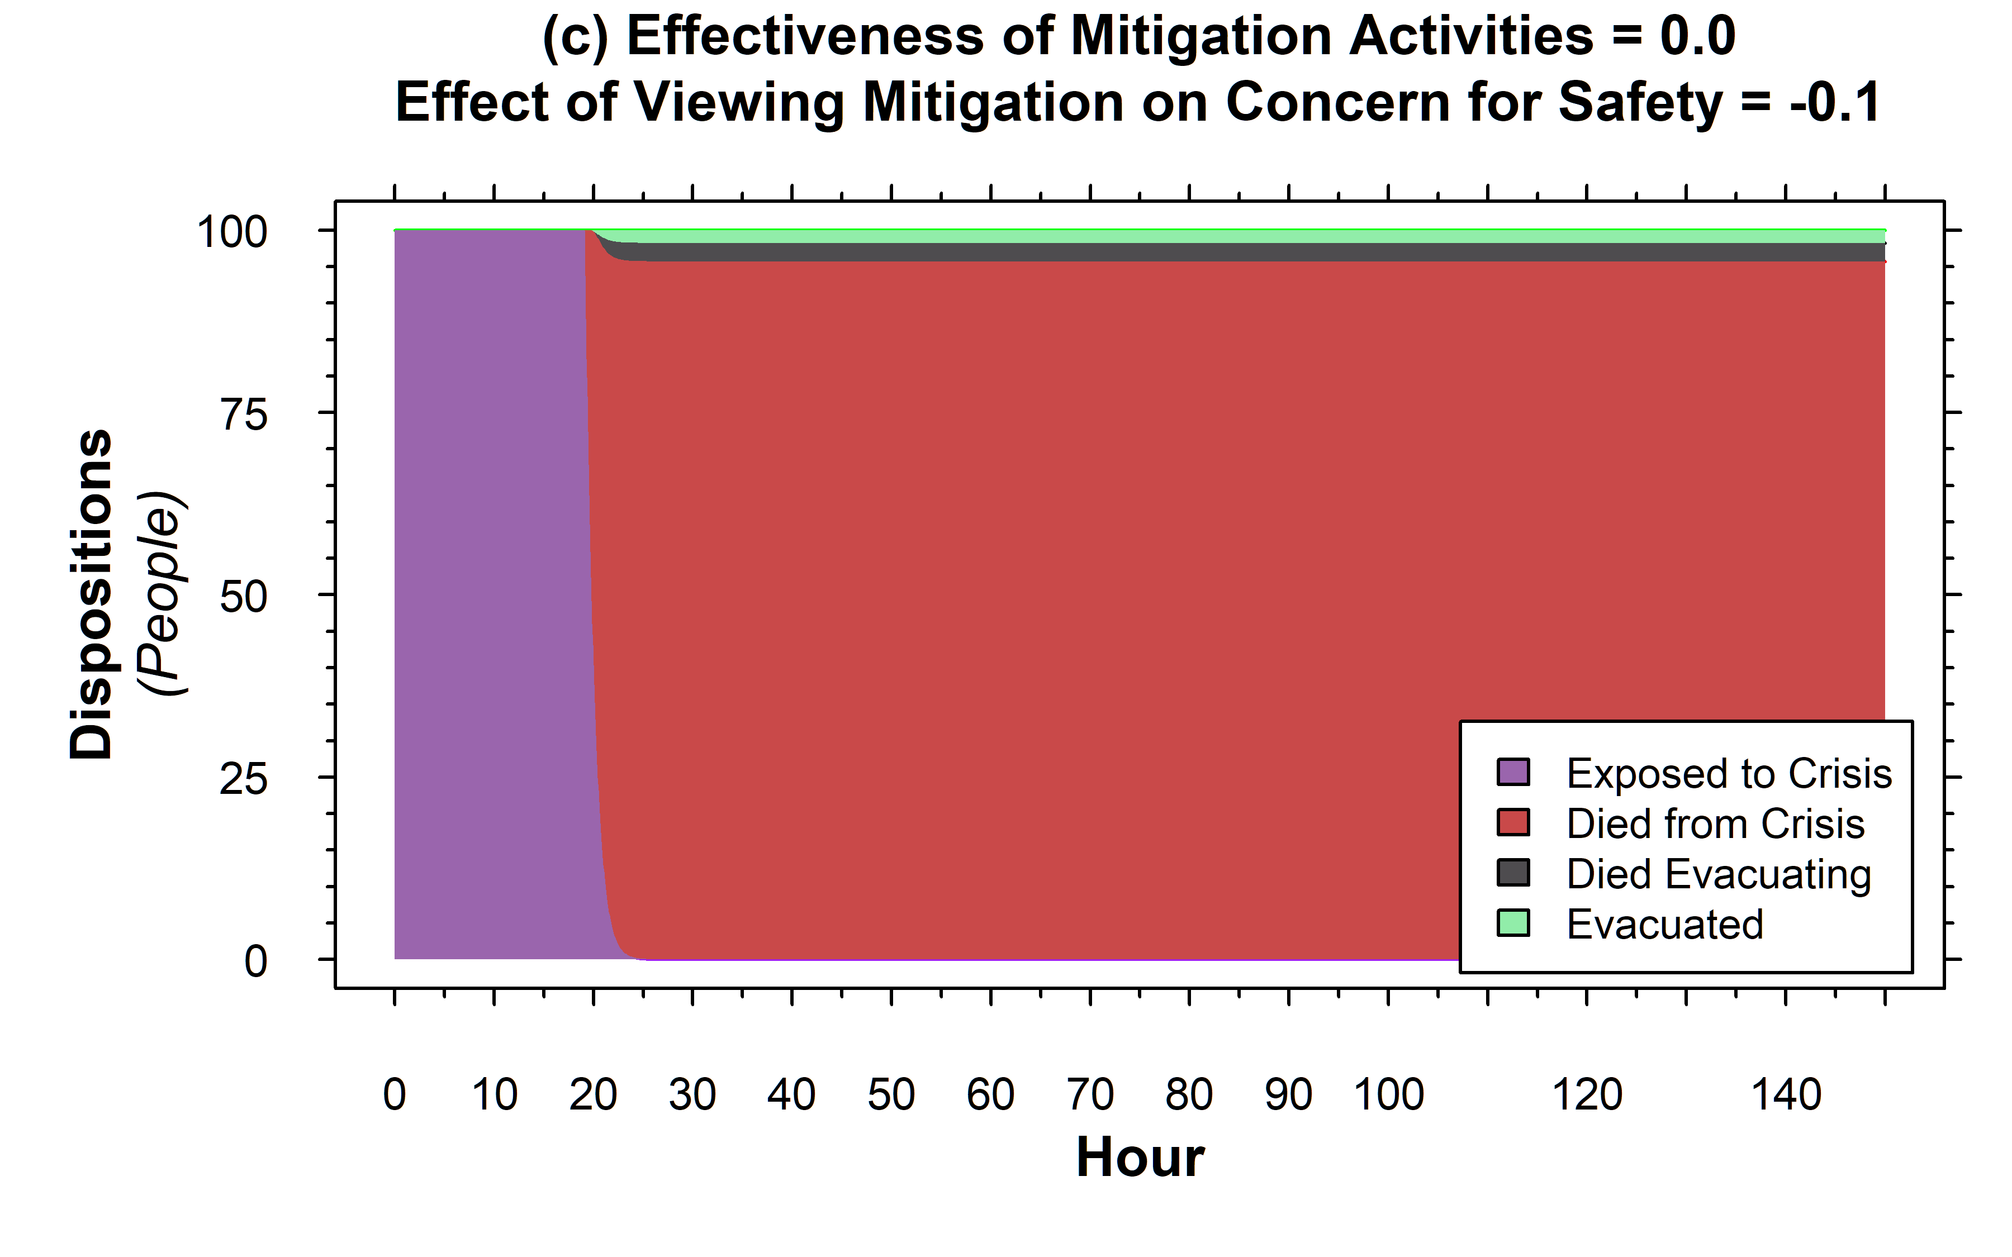
Rearranging the Deck Chairs on the Titanic
A Simulation Model Of Behavioral Resource Utilization Under Crisis
James E. Paine MIT Sloan School of Management – System Dynamics Group
BACKGROUND
X
=
Summary
Model Structure and Key Mechanisms
Model Files and Additional Documentation at:
https://github.com/jpain3/ Rearranging-the-Deck-Chairs
This work presents a compartmental differential equation model that explores the interplay of stress response and action efficacy in group survivability during a crisis
Highlights that calming but even marginally effective mitigation activities can stabilize or improve crisis outcomes, while a calming but totally non-effective mitigation activity can severely worsen outcomes
Provides framework for future examination of balancing the expenditure of human resources as a function of both effect of actions on offsetting system decay and how those actions affect the stress response of those in the evolving crisis
Context-Dependent ‘physics’ of a crisis aggregated
“Rearranging the deck chairs on the Titanic is used metaphorically “to occupy oneself with some trivial activity while ignoring something much more important.”
Mitigation activities during crisis can have two purposes: buying time and calming people down.
Under what circumstances could “rearranging the deck chairs” or any possibly preventative, even seemingly trivial, activity during a crisis be helpful?
During an actively unfolding crisis, the ability to identify activities as ‘trivial’ versus essential can be unclear. What mechanisms separate different outcomes during crisis management?
Focus of this model is on behavioral responses and feedback
Capturing Effect of Stress on Performance
X
=
See Rudolph & Repenning (2006) DOI: 10.2307/3094889
Crisis Mitigation can be stressful or calming
Evacuation is not Necessarily Successful
*Note: diagram uses visual language of compartmental models discussed in Sterman, J. D. (2000) “Business Dynamics-Systems Thinking and Modeling for a Complex World”. McGraw- Hill Higher Education. ISBN 0072311355
Polarity of Loop through Mitigation Efforts can be Reinforcing OR Balancing
Reinforcing if sign on Effect is >0
Balancing if sign on Effect is <0
Evacuation Efficacy affected by stress response
Death in the system occurs below critical capability threshold
Varying Crisis Progression Rate
Varying Effect of Viewing Mitigation
Marginally Effective vs Non-Effective Mitigation
Positive effect of calming mitigation lost when mitigation is totally ineffective
For very calming mitigation, can get ‘head in the sand’ outcome with negligible evacuation
This is ‘rearranging the deckchairs’

